Slide 1
Stochastic Neural Networks with Variational Inference
Kyeong Ryeol, Go
M.S. Candidate of OSI Lab

Slide 2
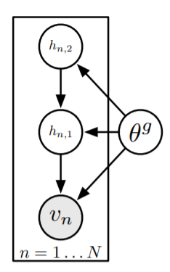
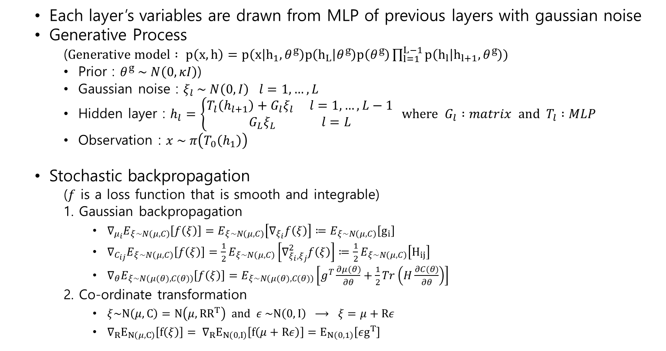

Deep Latent Gaussian Models (DLGMs)
Each layer’s variables are drawn from MLP of previous layers with gaussian noise
Generative Process
($Generative model : p\left(x,h\right)=p\left(x | h_{1},θ^{g}\right)p\left(h_{L} | θ^{g}\right)p\left(θ^{g}\right)\prod_{l=1}^{L−1}{p\left(h_{l} | h_{l+1},θ^{g}\right)}$)
Prior : $θ^{g} \sim N\left(0, κI\right)$)
Gaussian noise : $ξ_{l} \sim N\left(0, I\right) l=1,…, L$
Hidden layer : $h_{l}=\left\{\begin{aligned}T_{l}\left(h_{l+1}\right)+G_{l}ξ_{l} l=1,…, L−1 \\ G_{L}ξ_{L} l=L\end{aligned}\right. where G_{l} :matrix and T_{l} :MLP$
Observation : $x \sim π\left(T_{0}\left(h_{1}\right)\right)$
Stochastic backpropagation
($f$ is a loss function that is smooth and integrable)
1. Gaussian backpropagation
$∇_{μ_{i}}E_{ξ\sim N\left(μ,C\right)}\left[f\left(ξ\right)\right]=E_{ξ\sim N\left(μ,C\right)}\left[∇_{ξ_{i}}f\left(ξ\right)\right]≔E_{ξ\sim N\left(μ,C\right)}\left[g_{i}\right]$
$∇_{C_{ij}}E_{ξ\sim N\left(μ,C\right)}\left[f\left(ξ\right)\right]=\frac{1}{2}E_{ξ\sim N\left(μ,C\right)}\left[∇_{ξ_{i},ξ_{j}}^{2}f\left(ξ\right)\right]≔\frac{1}{2}E_{ξ\sim N\left(μ,C\right)}\left[H_{ij}\right]$
$∇_{θ}E_{ξ\sim N\left(μ(θ),C(θ)\right)}\left[f\left(ξ\right)\right]=E_{ξ\sim N\left(μ(θ),C(θ)\right)}\left[g^{T}\frac{∂μ(θ)}{∂θ}+\frac{1}{2}Tr\left(H\frac{∂C(θ)}{∂θ}\right)\right]$
2. Co-ordinate transformation
$ξ\sim N\left(μ,C\right)=N\left(μ,{RR}^{T}\right) and ε \sim N\left(0,I\right) ⟶ ξ=μ+Rε$
$∇_{R}E_{N\left(μ,C\right)}\left[f\left(ξ\right)\right]= ∇_{R}E_{N\left(0,I\right)}\left[f\left(μ+Rε\right)\right]=E_{N\left(0,1\right)}\left[εg^{T}\right]$
$x_{n}$

Slide 3
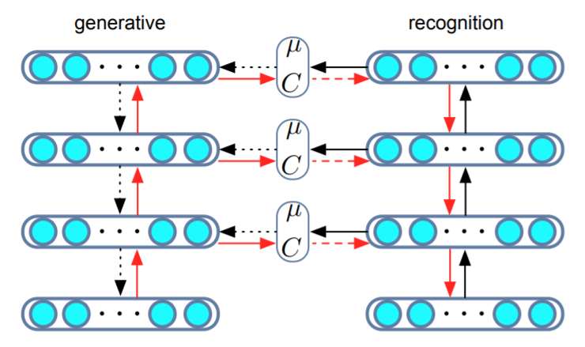
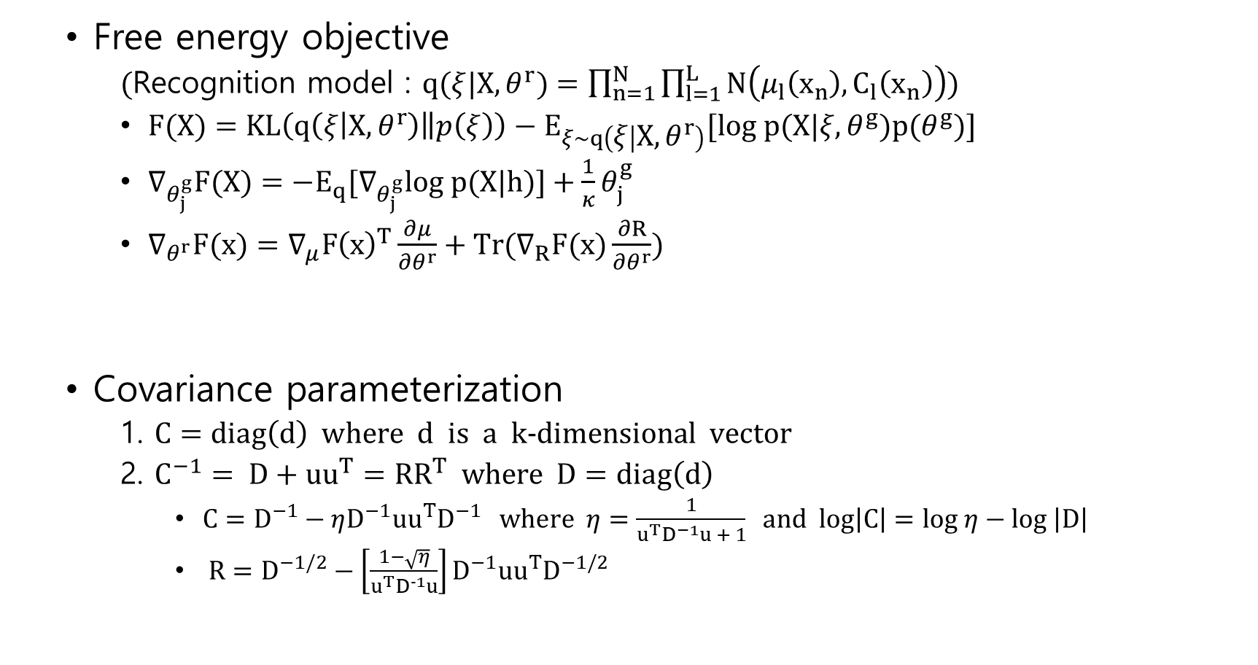
(continued)
Free energy objective
(Recognition model : $q(ξ|X,θ^{r})=\prod_{n=1}^{N}{\prod_{l=1}^{L}{N\left(μ_{l}\left(x_{n}\right),C_{l}\left(x_{n}\right)\right)}}$)
$F(X)=KL\left(q\left(ξ | X,θ^{r}\right)\left\|p\left(ξ\right)\right.\right)−E_{ξ\sim q\left(ξ | X,θ^{r}\right)}[log p(X|ξ,θ^{g})p(θ^{g})]$
$∇_{θ_{j}^{g}}F(X)=−E_{q}[∇_{θ_{j}^{g}}log p(X|h)]+\frac{1}{κ}θ_{j}^{g}$
$∇_{θ^{r}}F(x)=∇_{μ}F{\left(x\right)}^{T}\frac{∂μ}{∂θ^{r}}+Tr(∇_{R}F(x)\frac{∂R}{∂θ^{r}})$
Covariance parameterization
1. $C=diag\left(d\right) where d is a k−dimensional vector$
2. $C^{−1}= D+{uu}^{T}={RR}^{T} where D=diag\left(d\right)$
$C=D^{−1}−ηD^{−1}{uu}^{T}D^{−1} where η=\frac{1}{u^{T}D^{−1}u + 1} and log\left|C\right|=log η−log \left|D\right|$
$R=D^{−1/2}−\left[\frac{1−\sqrt{η}}{u^{T}D^{−1}u}\right]D^{−1}{uu}^{T}D^{−1/2}$

Slide 4
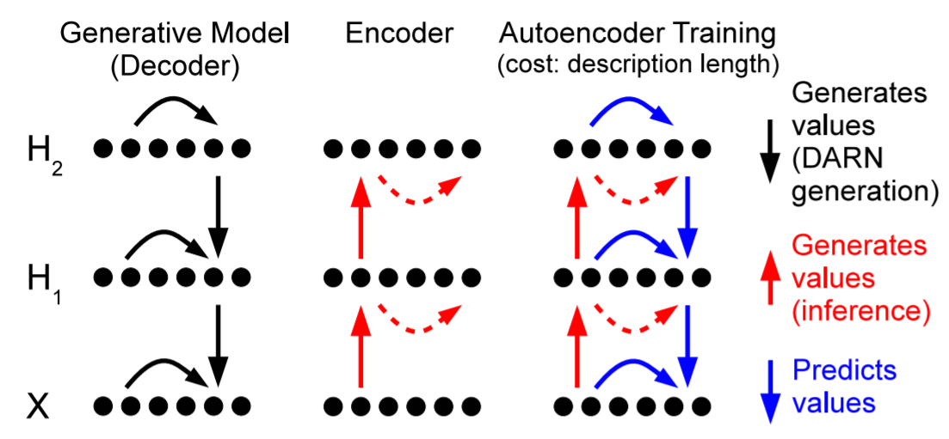
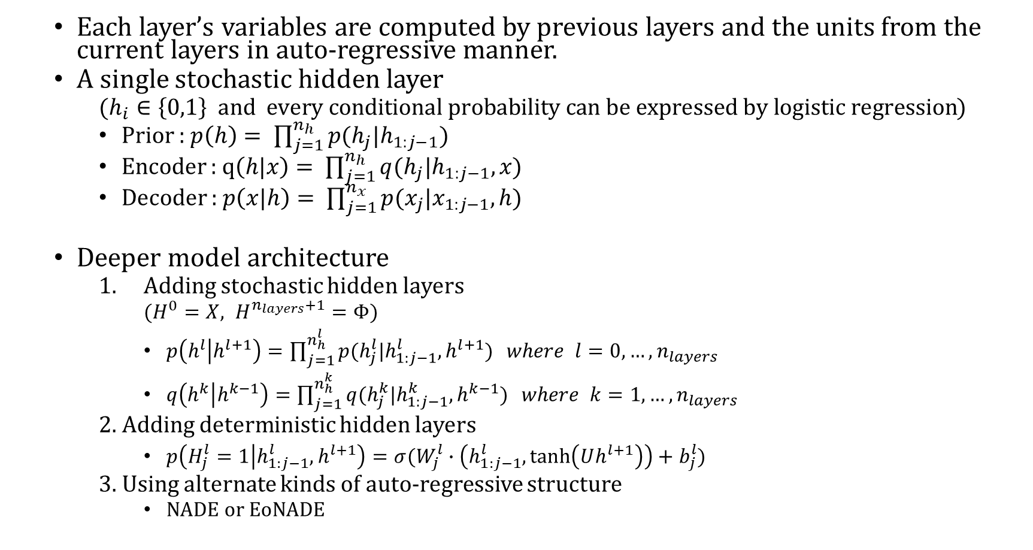
Deep Auto-Regressive Networks (DARNs)
Each layer’s variables are computed by previous layers and the units from the current layers in auto-regressive manner.
A single stochastic hidden layer
($h_{i}∈\left\{0,1\right\} and every conditional probability can be expressed by logistic regression$)
Prior : $p\left(h\right)= \prod_{j=1}^{n_{h}}{p(h_{j}|h_{1:j−1})}$
Encoder : $q\left(h|x\right)= \prod_{j=1}^{n_{h}}{q(h_{j}|h_{1:j−1},x)}$
Decoder : $p\left(x|h\right)= \prod_{j=1}^{n_{x}}{p(x_{j}|x_{1:j−1}, h)}$
Deeper model architecture
Adding stochastic hidden layers
($H^{0}=X, H^{n_{layers}+1}=Φ$)
$p\left(h^{l} | h^{l+1}\right)=\prod_{j=1}^{n_{h}^{l}}{p(h_{j}^{l}|h_{1:j−1}^{l},h^{l+1})} where l=0,…,n_{layers}$
$q\left(h^{k} | h^{k−1}\right)=\prod_{j=1}^{n_{h}^{k}}{q(h_{j}^{k}|h_{1:j−1}^{k}, h^{k−1})} where k=1,…,n_{layers}$
2. Adding deterministic hidden layers
$p\left(H_{j}^{l}=1 | h_{1:j−1}^{l}, h^{l+1}\right)=σ(W_{j}^{l}∙\left(h_{1:j−1}^{l},\tanh\left(Uh^{l+1}\right)\right)+b_{j}^{l})$
3. Using alternate kinds of auto-regressive structure
NADE or EoNADE

Slide 5
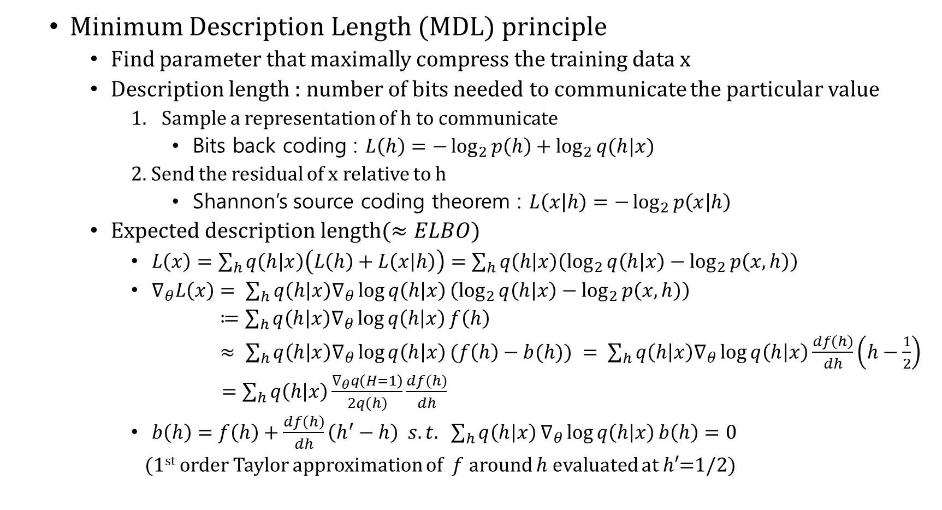
(continued)
Minimum Description Length (MDL) principle
Find parameter that maximally compress the training data x
Description length : number of bits needed to communicate the particular value
Sample a representation of h to communicate
Bits back coding : $L\left(h\right)=−\log_{2}{p\left(h\right)}+\log_{2}{q(h|x)}$
2. Send the residual of x relative to h
Shannon’s source coding theorem : $L\left(x | h\right)=−\log_{2}{p\left(x | h\right)}$
Expected description length($≈ELBO$)
$L\left(x\right)=\sum_{h}{q\left(h | x\right)\left(L\left(h\right)+L\left(x | h\right)\right)}=\sum_{h}{q\left(h | x\right)\left(\log_{2}{q\left(h | x\right)}−\log_{2}{p\left(x,h\right)}\right)}$
$∇_{θ}L\left(x\right)= \sum_{h}{q\left(h | x\right)∇_{θ}\log{q\left(h | x\right)}}\left(\log_{2}{q\left(h | x\right)}−\log_{2}{p\left(x,h\right)}\right)$
$≔\sum_{h}{q\left(h | x\right)∇_{θ}\log{q\left(h | x\right)}f\left(h\right)}$
$≈ \sum_{h}{q\left(h | x\right)∇_{θ}\log{q\left(h | x\right)}(f\left(h\right)−b(h)}) = \sum_{h}{q\left(h | x\right)∇_{θ}\log{q\left(h | x\right)}\frac{df\left(h\right)}{dh}\left(h−\frac{1}{2}\right)}$
$=\sum_{h}{q\left(h | x\right)\frac{∇_{θ}q\left(H=1\right)}{2q\left(h\right)}\frac{df(h)}{dh}}$
$b\left(h\right)=f\left(h\right)+\frac{df\left(h\right)}{dh}\left(h^{′}−h\right) s.t. \sum_{h}{q\left(h | x\right)}∇_{θ}\log{q\left(h | x\right)}b\left(h\right)=0$
(1st order Taylor approximation of $f$ around $h$ evaluated at $h′$=1/2)

Slide 6
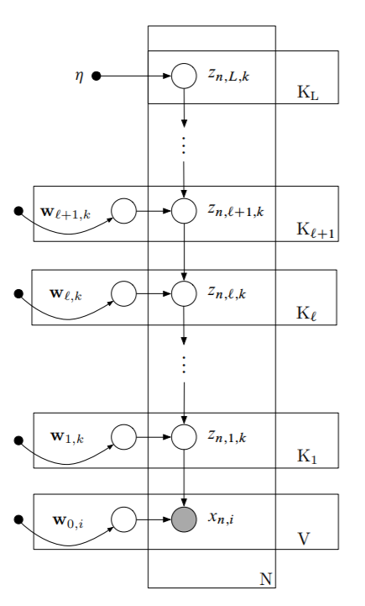
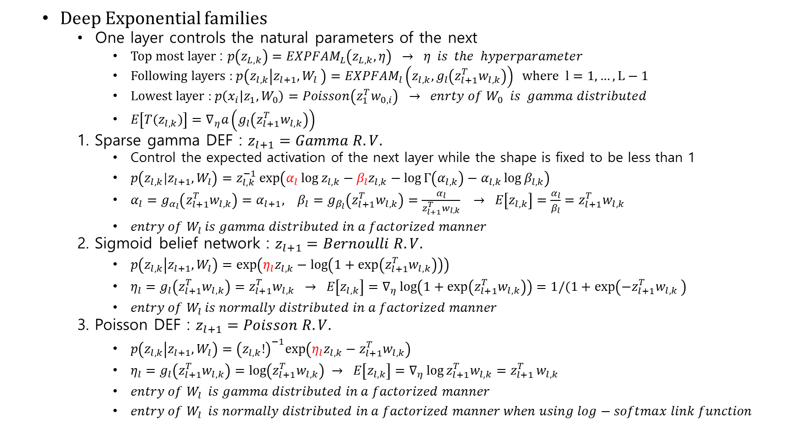
Deep Exponential Families (DEFs)
Deep Exponential families
One layer controls the natural parameters of the next
Top most layer : $p\left(z_{L,k}\right)=EXPFAM_{L}\left(z_{L,k}, η\right) → η is the hyperparameter$
Following layers : $p\left(z_{l,k} | z_{l+1},W_{l} \right)=EXPFAM_{l}\left(z_{l,k}, g_{l}\left(z_{l+1}^{T}w_{l,k}\right)\right) where l=1,…,L−1$
Lowest layer : $p\left(x_{i} | z_{1},W_{0}\right)=Poisson\left(z_{1}^{T}w_{0,i}\right) → enrty of W_{0} is gamma distributed$
$E\left[T(z_{l,k})\right]=∇_{η}a\left(g_{l}\left(z_{l+1}^{T}w_{l,k}\right)\right)$
1. Sparse gamma DEF : $z_{l+1}=Gamma R.V.$
Control the expected activation of the next layer while the shape is fixed to be less than 1
$p\left(z_{l,k}|z_{l+1}, W_{l}\right)=z_{l,k}^{−1}\exp\left(α_{l}\log{z_{l,k}}−β_{l}z_{l,k}−\log{Γ\left(α_{l,k}\right)}−α_{l,k}\log{β_{l,k}}\right)$
$α_{l}=g_{α_{l}}\left(z_{l+1}^{T}w_{l,k}\right)=α_{l+1}, β_{l}=g_{β_{l}}\left(z_{l+1}^{T}w_{l,k}\right)=\frac{α_{l}}{z_{l+1}^{T}w_{l,k}} → E\left[z_{l,k}\right]=\frac{α_{l}}{β_{l}}=z_{l+1}^{T}w_{l,k}$
$entry of W_{l} is gamma distributed in a factorized manner$
2. Sigmoid belief network : $z_{l+1}=Bernoulli R.V.$
$p\left(z_{l,k} | z_{l+1}, W_{l}\right)=\exp\left(η_{l}z_{l,k}−\log\left(1+\exp\left(z_{l+1}^{T}w_{l,k}\right)\right)\right)$
$η_{l}=g_{l}\left(z_{l+1}^{T}w_{l,k}\right)=z_{l+1}^{T}w_{l,k} → E\left[z_{l,k}\right]=∇_{η}\log\left(1+\exp\left(z_{l+1}^{T}w_{l,k}\right)\right)=1/(1+\exp\left(−z_{l+1}^{T}w_{l,k} \right)$
$entry of W_{l} is normally distributed in a factorized manner$
3. Poisson DEF : $z_{l+1}=Poisson R.V.$
$p\left(z_{l,k} | z_{l+1}, W_{l}\right)={\left(z_{l,k}!\right)}^{−1}exp\left(η_{l}z_{l,k}−z_{l+1}^{T}w_{l,k}\right)$
$η_{l}=g_{l}\left(z_{l+1}^{T}w_{l,k}\right)=\log\left(z_{l+1}^{T}w_{l,k}\right) → E\left[z_{l,k}\right]=∇_{η}\log{z_{l+1}^{T}w_{l,k}}=z_{l+1 }^{T}w_{l,k}$
$entry of W_{l} is gamma distributed in a factorized manner$
$entry of W_{l} is normally distributed in a factorized manner when using log−softmax link function$

Slide 7
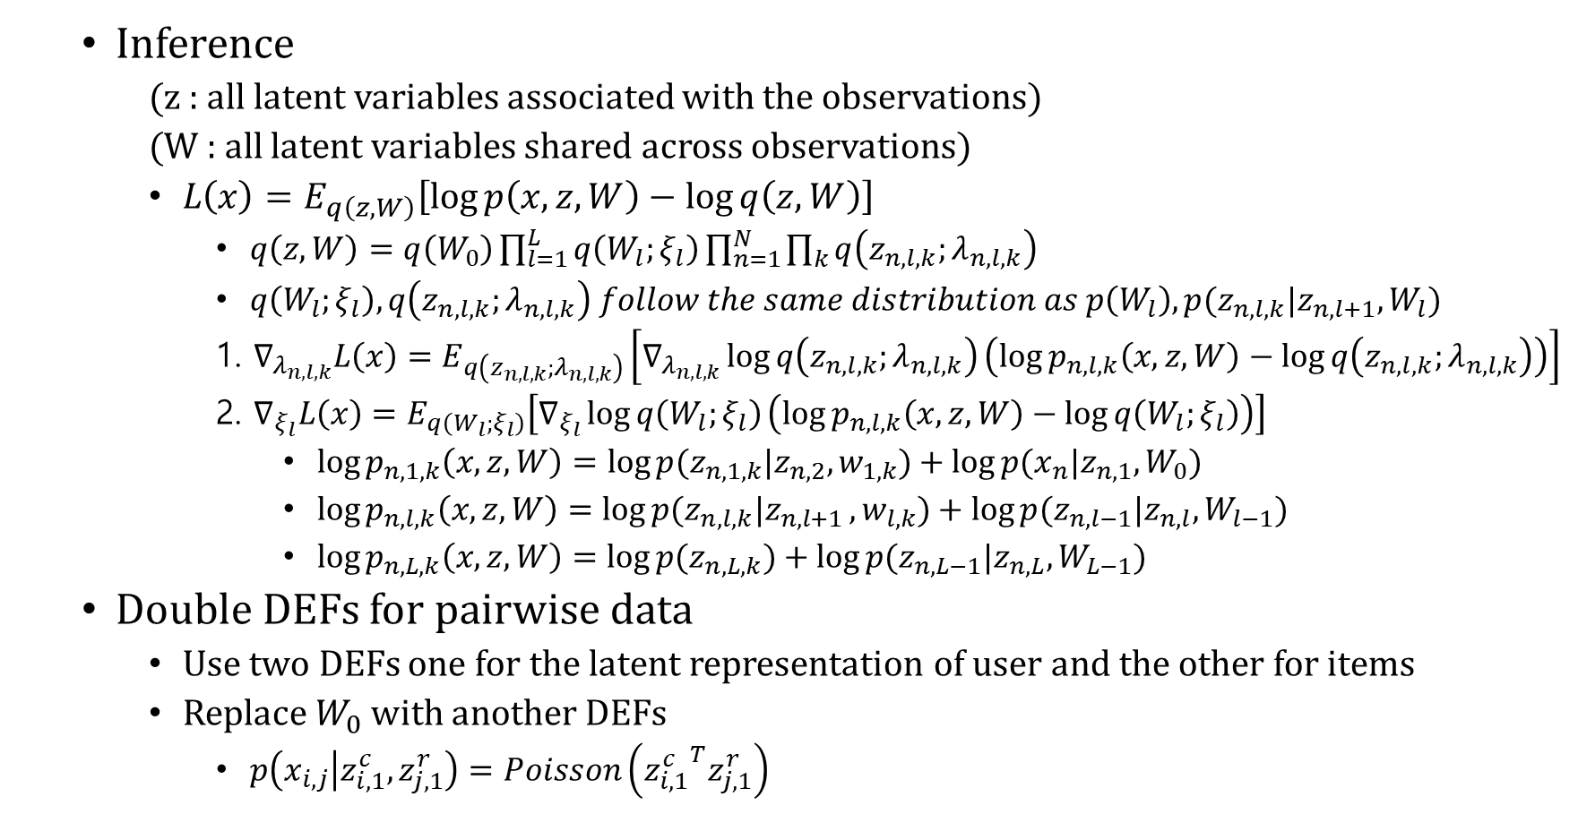
(continued)
Inference
(z : all latent variables associated with the observations)
(W : all latent variables shared across observations)
$L\left(x\right)=E_{q\left(z,W\right)}\left[\log{p\left(x,z,W\right)}−\log{q\left(z,W\right)}\right]$
$q\left(z,W\right)=q\left(W_{0}\right)\prod_{l=1}^{L}{q\left(W_{l};ξ_{l}\right)}\prod_{n=1}^{N}{\prod_{k}{q\left(z_{n,l,k};λ_{n,l,k}\right)}}$
$q\left(W_{l};ξ_{l}\right), q\left(z_{n,l,k};λ_{n,l,k}\right) follow the same distribution as p\left(W_{l}\right), p(z_{n,l,k}|z_{n,l+1},W_{l})$
1. $∇_{λ_{n,l,k}}L\left(x\right)=E_{q\left(z_{n,l,k};λ_{n,l,k}\right)}\left[∇_{λ_{n,l,k}}\log{q\left(z_{n,l,k};λ_{n,l,k}\right)}\left(\log{p_{n,l,k}\left(x,z,W\right)}−\log{q\left(z_{n,l,k};λ_{n,l,k}\right)}\right)\right]$
2. $∇_{ξ_{l}}L\left(x\right)=E_{q\left(W_{l};ξ_{l}\right)}\left[∇_{ξ_{l}}\log{q\left(W_{l};ξ_{l}\right)}\left(\log{p_{n,l,k}\left(x,z,W\right)}−\log{q\left(W_{l};ξ_{l}\right)}\right)\right]$
$\log{p_{n,1,k}\left(x,z,W\right)}=\log{p(z_{n,1,k}|z_{n,2},w_{1,k})}+\log{p(x_{n}|z_{n,1}, W_{0})}$
$\log{p_{n,l,k}\left(x,z,W\right)}=\log{p(z_{n,l,k}|z_{n,l+1 }, w_{l,k})}+\log{p(z_{n,l−1}|z_{n,l},W_{l−1})}$
$\log{p_{n,L,k}\left(x,z,W\right)}=\log{p(z_{n,L,k})}+\log{p(z_{n,L−1}|z_{n,L},W_{L−1})}$
Double DEFs for pairwise data
Use two DEFs one for the latent representation of user and the other for items
Replace $W_{0}$ with another DEFs
$p\left(x_{i,j} | z_{i, 1}^{c},z_{j, 1}^{r}\right)=Poisson\left({z_{i, 1}^{c}}^{T}z_{j, 1}^{r}\right)$

Slide 8
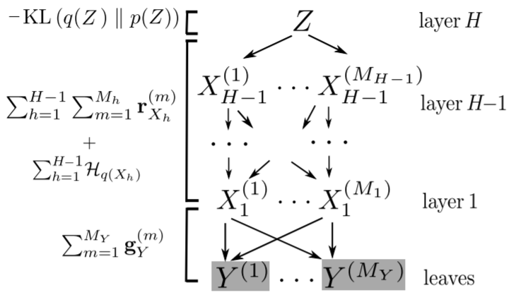
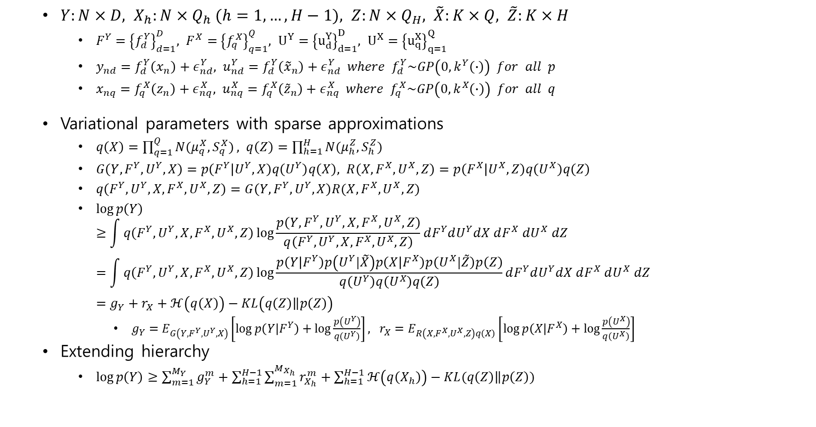
Deep Gaussian Processes
$Y:N×D, X_{h}:N×Q_{h} (h=1,…,H−1), Z:N×Q_{H}, \tilde{X}:K×Q, \tilde{Z}:K×H$
$F^{Y}={\left\{f_{d}^{Y}\right\}}_{d=1}^{D}, F^{X}={\left\{f_{q}^{X}\right\}}_{q=1}^{Q}, U^{Y}={\left\{u_{d}^{Y}\right\}}_{d=1}^{D}, U^{X}={\left\{u_{q}^{X}\right\}}_{q=1}^{Q}$
$y_{nd}=f_{d}^{Y}\left(x_{n}\right)+ε_{nd}^{Y}, u_{nd}^{Y}=f_{d}^{Y}\left({\tilde{x}}_{n}\right)+ε_{nd}^{Y} where f_{d}^{Y}\sim GP\left(0, k^{Y}\left(∙\right)\right) for all p$
$x_{nq}=f_{q}^{X}\left(z_{n}\right)+ε_{nq}^{X}, u_{nq}^{X}=f_{q}^{X}\left({\tilde{z}}_{n}\right)+ε_{nq}^{X} where f_{q}^{X}\sim GP\left(0, k^{X}\left(∙\right)\right) for all q$
Variational parameters with sparse approximations
$q\left(X\right)=\prod_{q=1}^{Q}{N(μ_{q}^{X}, S_{q}^{X})}, q\left(Z\right)=\prod_{h=1}^{H}{N(μ_{h}^{Z}, S_{h}^{Z})}$
$G\left(Y,F^{Y},U^{Y},X\right)=p\left(F^{Y} | U^{Y},X\right)q\left(U^{Y}\right)q\left(X\right), R\left(X,F^{X},U^{X},Z\right)=p\left(F^{X} | U^{X},Z\right)q\left(U^{X}\right)q\left(Z\right)$
$q\left(F^{Y},U^{Y},X, F^{X},U^{X},Z\right)=G\left(Y,F^{Y},U^{Y},X\right)R(X,F^{X},U^{X},Z)$
$\log{p\left(Y\right)}$ $≥\int{q\left(F^{Y},U^{Y},X, F^{X},U^{X},Z\right)\log{\frac{p\left(Y, F^{Y},U^{Y},X, F^{X},U^{X},Z\right)}{q\left(F^{Y},U^{Y},X, F^{X},U^{X},Z\right)}}}dF^{Y}dU^{Y}dX dF^{X} dU^{X} dZ$ $=\int{q\left(F^{Y},U^{Y},X, F^{X},U^{X},Z\right)}\log{\frac{p\left(Y | F^{Y}\right)p\left(U^{Y}|\tilde{X}\right)p\left(X | F^{X}\right)p\left(U^{X}|\tilde{Z}\right)p\left(Z\right)}{q\left(U^{Y}\right)q\left(U^{X}\right)q\left(Z\right)}}dF^{Y}dU^{Y}dX dF^{X} dU^{X} dZ$ $=g_{Y}+r_{X}+ℋ\left(q\left(X\right)\right)−KL\left(\left.q\left(Z\right)\right\|p\left(Z\right)\right)$
$g_{Y}=E_{G\left(Y,F^{Y},U^{Y},X\right)}\left[\log{p\left(Y | F^{Y}\right)}+\log{\frac{p\left(U^{Y}\right)}{q\left(U^{Y}\right)}}\right], r_{X}=E_{R\left(X,F^{X},U^{X},Z\right)q\left(X\right)}\left[\log{p\left(X | F^{X}\right)}+\log{\frac{p\left(U^{X}\right)}{q\left(U^{X}\right)}}\right]$
Extending hierarchy
$\log{p\left(Y\right)}≥\sum_{m=1}^{M_{Y}}{g_{Y}^{m}}+\sum_{h=1}^{H−1}{\sum_{m=1}^{M_{X_{h}}}{r_{X_{h}}^{m}}}+\sum_{h=1}^{H−1}{ℋ\left(q\left(X_{h}\right)\right)}−KL(\left.q\left(Z\right)\right\|p\left(Z\right))$

Slide 9
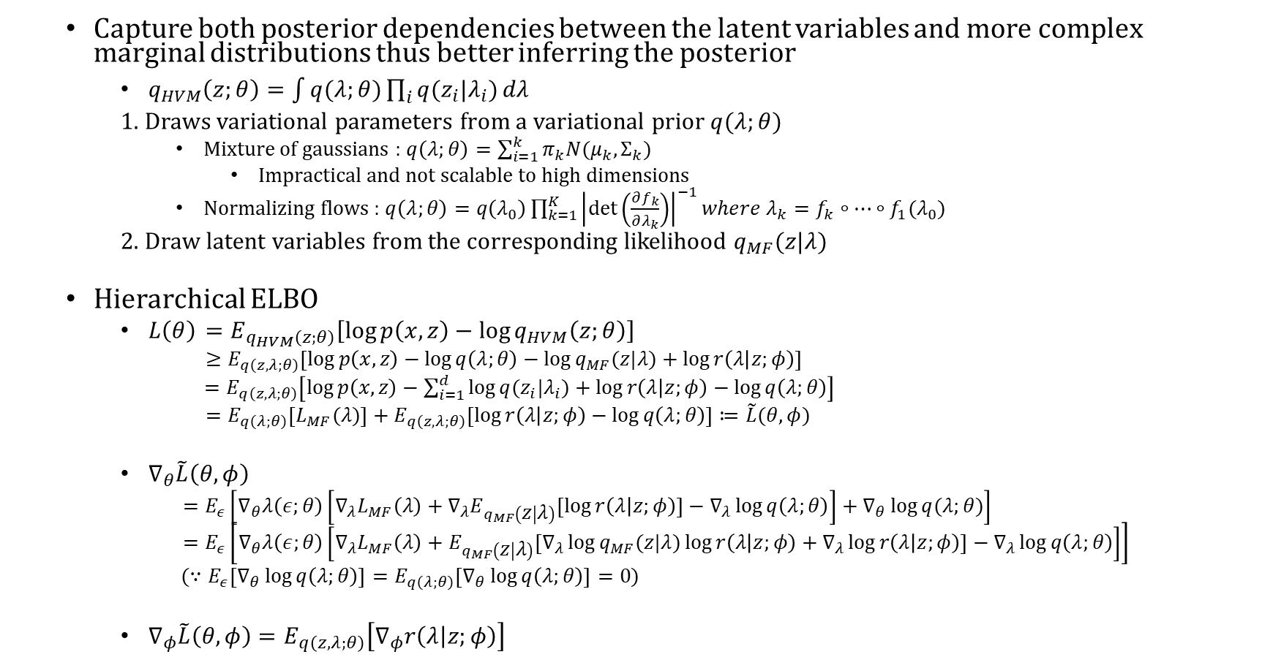
Hierarchical Variational Models (HVMs)
Capture both posterior dependencies between the latent variables and more complex marginal distributions thus better inferring the posterior
$q_{HVM}\left(z;θ\right)=\int{q(λ;θ)\prod_{i}{q(z_{i}|λ_{i})}}dλ$
1. Draws variational parameters from a variational prior $q(λ;θ)$
Mixture of gaussians : $q\left(λ;θ\right)=\sum_{i=1}^{k}{π_{k}N(μ_{k}, Σ_{k})}$
Impractical and not scalable to high dimensions
Normalizing flows : $q\left(λ;θ\right)=q\left(λ_{0}\right)\prod_{k=1}^{K}{{\left|\det\left(\frac{∂f_{k}}{∂λ_{k}}\right)\right|}^{−1}}where λ_{k}=f_{k}∘…∘f_{1}(λ_{0})$
2. Draw latent variables from the corresponding likelihood $q_{MF}(z|λ)$
Hierarchical ELBO
$L\left(θ\right)$ $=E_{q_{HVM}\left(z;θ\right)}\left[\log{p\left(x,z\right)}−\log{q_{HVM}\left(z;θ\right)}\right]$
$≥E_{q\left(z,λ;θ\right)}\left[\log{p\left(x,z\right)}−\log{q\left(λ;θ\right)}−\log{q_{MF}(z|λ)}+\log{r\left(λ | z;φ\right)}\right]$
$=E_{q\left(z,λ;θ\right)}\left[\log{p\left(x,z\right)}−\sum_{i=1}^{d}{\log{q(z_{i}|λ_{i})}}+\log{r\left(λ | z;φ\right)}−\log{q\left(λ;θ\right)}\right]$
$=E_{q\left(λ;θ\right)}\left[L_{MF}(λ)\right]+E_{q\left(z,λ;θ\right)}\left[\log{r\left(λ | z;φ\right)}−\log{q\left(λ;θ\right)}\right]≔\tilde{L}(θ,φ)$
$∇_{θ}\tilde{L}\left(θ,φ\right)$
$=E_{ε}\left[∇_{θ}λ\left(ε;θ\right)\left[∇_{λ}L_{MF}\left(λ\right)+∇_{λ}E_{q_{MF}\left(z | λ\right)}\left[\log{r\left(λ | z;φ\right)}\right]−∇_{λ}\log{q\left(λ;θ\right)}\right]+∇_{θ}\log{q(λ;θ)}\right]$
$=E_{ε}\left[∇_{θ}λ\left(ε;θ\right)\left[∇_{λ}L_{MF}\left(λ\right)+E_{q_{MF}\left(z | λ\right)}\left[∇_{λ}\log{q_{MF}(z|λ)}\log{r\left(λ | z;φ\right)}+∇_{λ}\log{r\left(λ | z;φ\right)}\right]−∇_{λ}\log{q\left(λ;θ\right)}\right]\right]$
($∵E_{ε}\left[∇_{θ}\log{q\left(λ;θ\right)}\right]=E_{q\left(λ;θ\right)}\left[∇_{θ}\log{q\left(λ;θ\right)}\right]=0$)
$∇_{φ}\tilde{L}\left(θ,φ\right)=E_{q\left(z,λ;θ\right)}\left[∇_{φ}r\left(λ | z;φ\right)\right]$

Slide 10
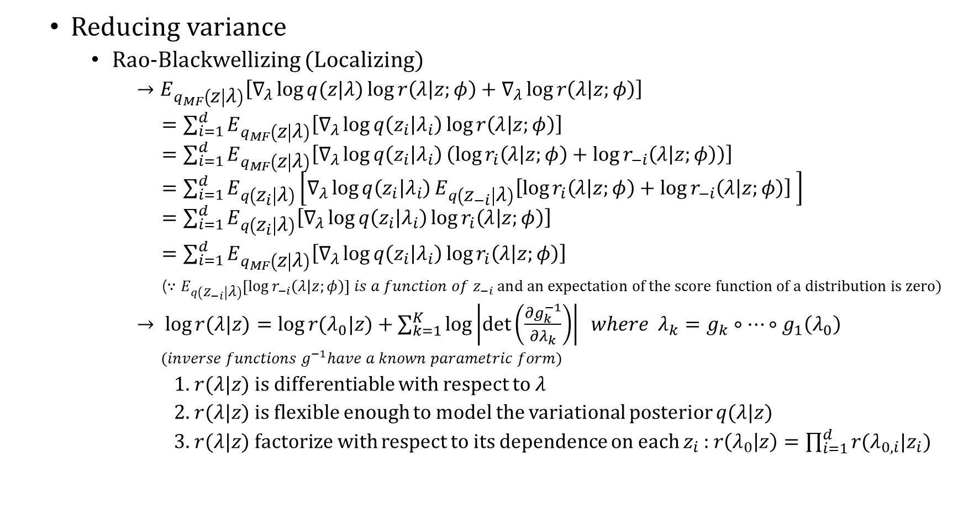
(continued)
Reducing variance
Rao-Blackwellizing (Localizing)
$→E_{q_{MF}\left(z | λ\right)}\left[∇_{λ}\log{q(z|λ)}\log{r\left(λ | z;φ\right)}+∇_{λ}\log{r\left(λ | z;φ\right)}\right]$
$=\sum_{i=1}^{d}{E_{q_{MF}\left(z | λ\right)}\left[∇_{λ}\log{q\left(z_{i} | λ_{i}\right)}\log{r\left(λ | z;φ\right)}\right]}$ $=\sum_{i=1}^{d}{E_{q_{MF}\left(z | λ\right)}\left[∇_{λ}\log{q\left(z_{i} | λ_{i}\right)}\left(\log{r_{i}\left(λ | z;φ\right)}+\log{r_{−i}\left(λ | z;φ\right)}\right)\right]}$ $=\sum_{i=1}^{d}{E_{q\left(z_{i} | λ\right)}\left[∇_{λ}\log{q\left(z_{i} | λ_{i}\right)}E_{q\left(z_{−i} | λ\right)}\left[\log{r_{i}\left(λ | z;φ\right)}+\log{r_{−i}\left(λ | z;φ\right)}\right] \right]}$ $=\sum_{i=1}^{d}{E_{q\left(z_{i} | λ\right)}\left[∇_{λ}\log{q\left(z_{i} | λ_{i}\right)}\log{r_{i}\left(λ | z;φ\right)}\right]}$
$=\sum_{i=1}^{d}{E_{q_{MF}\left(z | λ\right)}\left[∇_{λ}\log{q\left(z_{i} | λ_{i}\right)}\log{r_{i}\left(λ | z;φ\right)}\right]}$
($∵E_{q\left(z_{−i} | λ\right)}\left[\log{r_{−i}\left(λ | z;φ\right)}\right] is a function of z_{−i} \text{and} \text{an} \text{expectation} \text{of} \text{the} \text{score} \text{function} \text{of} \text{a} \text{distribution} \text{is} \text{zero}\text{)}$
$→ \log{r(λ|z)}=\log{r(λ_{0}|z)}+\sum_{k=1}^{K}{\log\left|\det\left(\frac{∂g_{k}^{−1}}{∂λ_{k}}\right)\right|} where λ_{k}=g_{k}∘…∘g_{1}\left(λ_{0}\right)$
$(inverse functions g^{−1}have a known parametric form)$
1. $r(λ|z)$ is differentiable with respect to $λ$
2. $r(λ|z)$ is flexible enough to model the variational posterior $q(λ|z)$
3. $r(λ|z)$ factorize with respect to its dependence on each $z_{i}$ : $r\left(λ_{0} | z\right)=\prod_{i=1}^{d}{r(λ_{0,i}|z_{i})}$

Slide 11
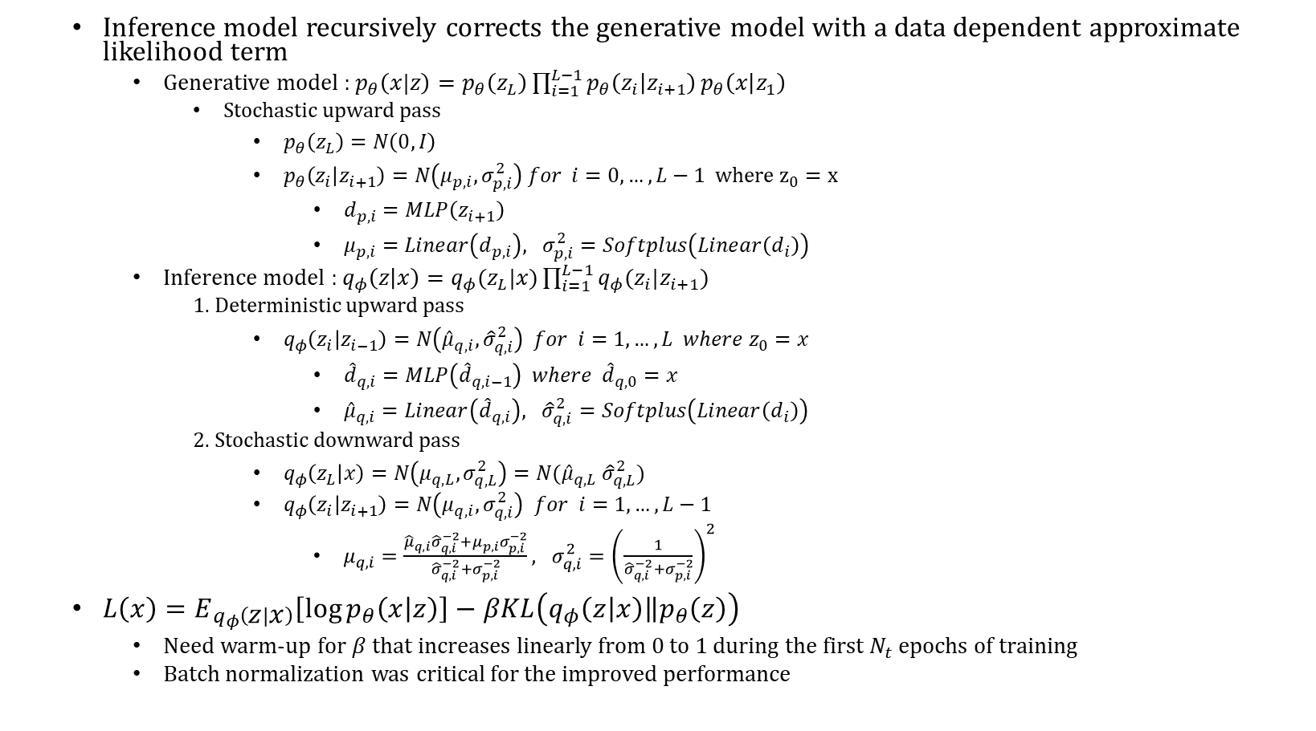
Ladder Variation Autoencoders (LVAE)
Inference model recursively corrects the generative model with a data dependent approximate likelihood term
Generative model : $p_{θ}\left(x|z\right)=p_{θ}\left(z_{L}\right)\prod_{i=1}^{L−1}{p_{θ}\left(z_{i} | z_{i+1}\right)}p_{θ}\left(x | z_{1}\right)$
Stochastic upward pass
$p_{θ}\left(z_{L}\right)=N\left(0,I\right)$
$p_{θ}\left(z_{i} | z_{i+1}\right)=N\left(μ_{p,i}, σ_{p,i}^{2}\right) for i=0,…,L−1 where z_{0}=x$
$d_{p,i}=MLP\left(z_{i+1}\right)$
$μ_{p,i}=Linear\left(d_{p,i}\right), σ_{p,i}^{2}=Softplus\left(Linear\left(d_{i}\right)\right)$
Inference model : $q_{φ}\left(z | x\right)=q_{φ}(z_{L}|x)\prod_{i=1}^{L−1}{q_{φ}(z_{i}|z_{i+1})}$
1. Deterministic upward pass
$q_{φ}\left(z_{i} | z_{i−1}\right)=N\left({\hat{μ}}_{q,i},{\hat{σ}}_{q,i}^{2}\right) for i=1,…,L where z_{0}=x$
${\hat{d}}_{q,i}=MLP\left({\hat{d}}_{q,i−1}\right) where {\hat{d}}_{q,0}=x$
${\hat{μ}}_{q,i}=Linear\left({\hat{d}}_{q,i}\right), {\hat{σ}}_{q,i}^{2}=Softplus\left(Linear\left(d_{i}\right)\right)$
2. Stochastic downward pass
$q_{φ}\left(z_{L} | x\right)=N\left(μ_{q,L},σ_{q,L}^{2}\right)=N({\hat{μ}}_{q,L} {\hat{σ}}_{q,L}^{2})$
$q_{φ}\left(z_{i} | z_{i+1}\right)=N\left(μ_{q,i},σ_{q,i}^{2}\right)$ $for i=1,…,L−1$
$μ_{q,i}=\frac{{\hat{μ}}_{q,i}{\hat{σ}}_{q,i}^{−2}+μ_{p,i}σ_{p,i}^{−2}}{{\hat{σ}}_{q,i}^{−2}+σ_{p,i}^{−2}}, σ_{q,i}^{2}={\left(\frac{1}{{\hat{σ}}_{q,i}^{−2}+σ_{p,i}^{−2}}\right)}^{2}$
$L\left(x\right)=E_{q_{φ}\left(z | x\right)}\left[\log{p_{θ}\left(x | z\right)}\right]−βKL\left(q_{φ}\left(z | x\right)\left\|p_{θ}\left(z\right)\right.\right)$
Need warm-up for $β$ that increases linearly from 0 to 1 during the first $N_{t}$ epochs of training
Batch normalization was critical for the improved performance

Slide 12
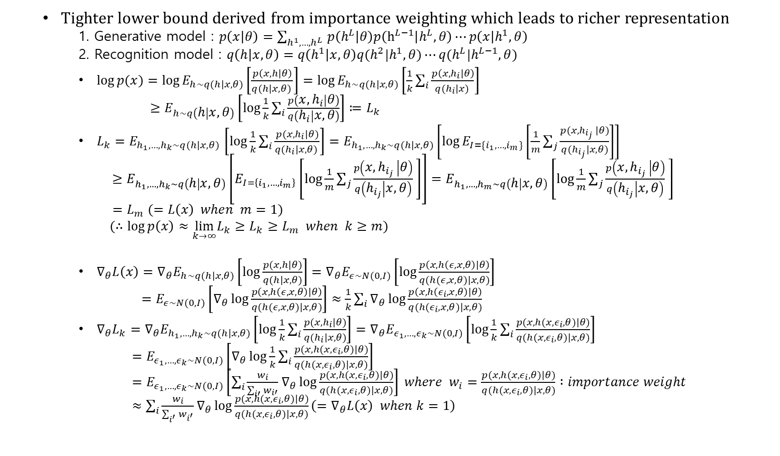
Importance Weighted Auto-Encoder (IWAE)
Tighter lower bound derived from importance weighting which leads to richer representation
1. Generative model : $p\left(x | θ\right)=\sum_{h^{1},…,h^{L} }{p\left(h^{L} | θ\right)p\left(h^{L−1} | h^{L}, θ\right)⋯p\left(x | h^{1}, θ\right)}$
2. Recognition model : $q\left(h | x, θ\right)=q\left(h^{1} | x, θ\right)q(h^{2}|h^{1}, θ)⋯q(h^{L}|h^{L−1}, θ)$
$\log{p(x)}=\log{E_{h\sim q(h|x, θ)}\left[\frac{p\left(x,h|θ\right)}{q(h|x, θ) }\right]}=\log{E_{h\sim q(h|x,θ)}\left[\frac{1}{k}\sum_{i}{\frac{p\left(x,h_{i}|θ\right)}{q(h_{i}|x) }}\right]}$
$≥E_{h\sim q\left(h | x,θ\right)}\left[\log{\frac{1}{k}\sum_{i}{\frac{p\left(x,h_{i} | θ\right)}{q\left(h_{i} | x, θ\right)}}}\right]≔L_{k}$
$L_{k}=E_{h_{1},…,h_{k}\sim q(h|x,θ) }\left[\log{\frac{1}{k}\sum_{i}{\frac{p(x,h_{i}|θ)}{q(h_{i}|x,θ) }}}\right]=E_{h_{1},…,h_{k}\sim q(h|x,θ)}\left[\log{E_{I=\{i_{1},…,i_{m}\}}\left[\frac{1}{m}\sum_{j}{\frac{p(x, h_{i_{j} }|θ)}{q(h_{i_{j}}|x,θ)}}\right]}\right]$
$≥E_{h_{1},…,h_{k}\sim q\left(h | x,θ\right)}\left[E_{I=\left\{i_{1},…,i_{m}\right\}}\left[\log{\frac{1}{m}\sum_{j}{\frac{p\left(x, h_{i_{j} } | θ\right)}{q\left(h_{i_{j}} | x,θ\right)} }}\right]\right]=E_{h_{1},…,h_{m}\sim q\left(h | x,θ\right)}\left[\log{\frac{1}{m}\sum_{j}{\frac{p\left(x, h_{i_{j} } | θ\right)}{q\left(h_{i_{j}} | x,θ\right)} }}\right]$
$=L_{m} (=L\left(x\right) when m=1)$
($∴\log{p\left(x\right)}≈\lim_{k→∞}L_{k}≥L_{k}≥L_{m} when k≥m$)
$∇_{θ}L\left(x\right)=∇_{θ}E_{h\sim q(h|x, θ)}\left[\log{\frac{p(x, h|θ)}{q(h|x,θ)}}\right]=∇_{θ}E_{ε\sim N(0, I)}\left[\log{\frac{p\left(x, h\left(ε, x, θ\right)|θ\right)}{q(h(ε,x,θ)|x,θ)}}\right]$
$=E_{ε\sim N(0,I)}\left[∇_{θ}\log{\frac{p\left(x, h\left(ε, x, θ\right)|θ\right)}{q(h(ε,x,θ)|x,θ)}}\right]≈\frac{1}{k}\sum_{i}{∇_{θ}\log{\frac{p\left(x, h\left(ε_{i}, x, θ\right)|θ\right)}{q(h(ε_{i},x,θ)|x,θ)}}}$
$∇_{θ}L_{k}=∇_{θ}E_{h_{1},…,h_{k}\sim q(h|x, θ)}\left[\log{\frac{1}{k}\sum_{i}{\frac{p(x, h_{i}|θ)}{q(h_{i}|x,θ)}}}\right]=∇_{θ}E_{ε_{1},…,ε_{k}\sim N(0,I)}\left[\log{\frac{1}{k}\sum_{i}{\frac{p(x, h(x, ε_{i},θ)|θ)}{q(h(x,ε_{i},θ)|x,θ)}}}\right]$
$=E_{ε_{1},…,ε_{k}\sim N(0,I)}\left[∇_{θ}\log{\frac{1}{k}\sum_{i}{\frac{p(x, h(x, ε_{i},θ)|θ)}{q(h(x,ε_{i},θ)|x,θ)}}}\right]$
$=E_{ε_{1},…,ε_{k}\sim N(0,I)}\left[\sum_{i}{\frac{w_{i}}{\sum_{i′}{w_{i′}}}}∇_{θ}\log{\frac{p(x, h(x, ε_{i},θ)|θ)}{q(h(x,ε_{i},θ)|x,θ)}}\right] where w_{i}=\frac{p(x, h(x, ε_{i},θ)|θ)}{q(h(x,ε_{i},θ)|x,θ)} :importance weight$
$≈\sum_{i}{\frac{w_{i}}{\sum_{i^{′}}{w_{i^{′}}}}}∇_{θ}\log{\frac{p(x, h(x, ε_{i},θ)|θ)}{q(h(x,ε_{i},θ)|x,θ)}}\left(=∇_{θ}L\left(x\right) when k=1\right)$

Slide 13
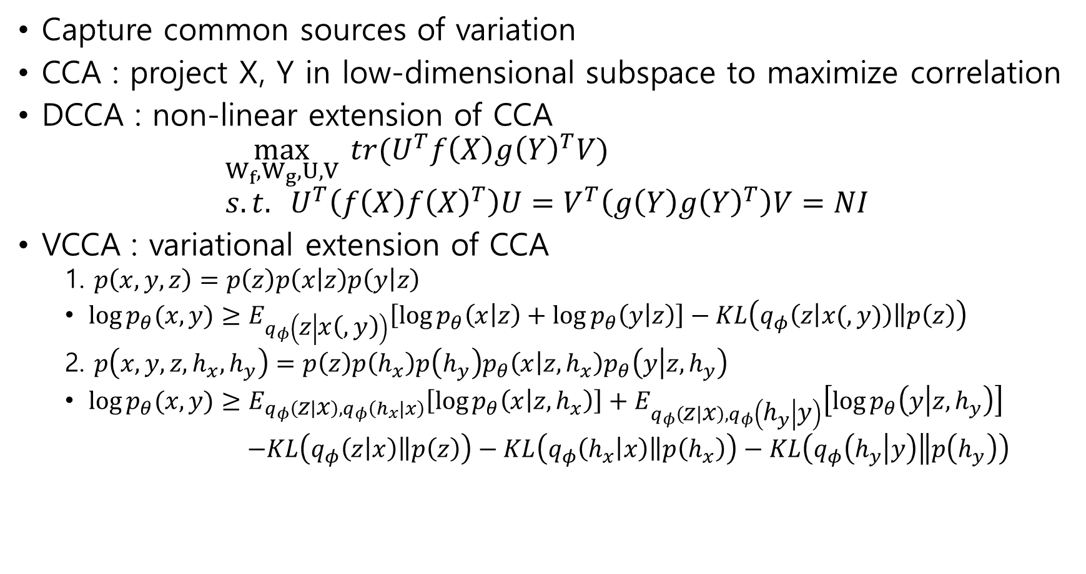
Variational Canonical Component Analysis
Capture common sources of variation
CCA : project X, Y in low-dimensional subspace to maximize correlation
DCCA : non-linear extension of CCA
$$\max_{W_{f},W_{g},U,V}{ tr(U^{T}f\left(X\right)g{\left(Y\right)}^{T}V)} \\ s.t. U^{T}\left(f\left(X\right)f{\left(X\right)}^{T}\right)U=V^{T}\left(g\left(Y\right)g{\left(Y\right)}^{T}\right)V=NI$$
VCCA : variational extension of CCA
1. $p\left(x,y,z\right)=p\left(z\right)p\left(x | z\right)p\left(y | z\right)$
$\log{p_{θ}(x,y)}≥E_{q_{φ}\left(z | x\left(,y\right)\right)}\left[\log{p_{θ}\left(x | z\right)}+\log{p_{θ}\left(y | z\right)}\right]−KL\left(q_{φ}\left(z | x(,y)\right)\left\|p\left(z\right)\right.\right)$
2. $p\left(x,y,z,h_{x}, h_{y}\right)=p\left(z\right)p\left(h_{x}\right)p\left(h_{y}\right)p_{θ}\left(x | z,h_{x}\right)p_{θ}\left(y | z,h_{y}\right)$
$\log{p_{θ}(x,y)}≥E_{q_{φ}\left(z | x\right),q_{φ}\left(h_{x}|x\right)}\left[\log{p_{θ}\left(x | z,h_{x}\right)}\right]+E_{q_{φ}\left(z | x\right),q_{φ}\left(h_{y} | y\right)}\left[\log{p_{θ}\left(y | z,h_{y}\right)}\right]$
$−KL\left(q_{φ}\left(z | x\right)\left\|p\left(z\right)\right.\right)−KL\left(q_{φ}\left(h_{x} | x\right)\left\|p\left(h_{x}\right)\right.\right)−KL\left(q_{φ}\left(h_{y} | y\right)\left\|p\left(h_{y}\right)\right.\right)$

Slide 14
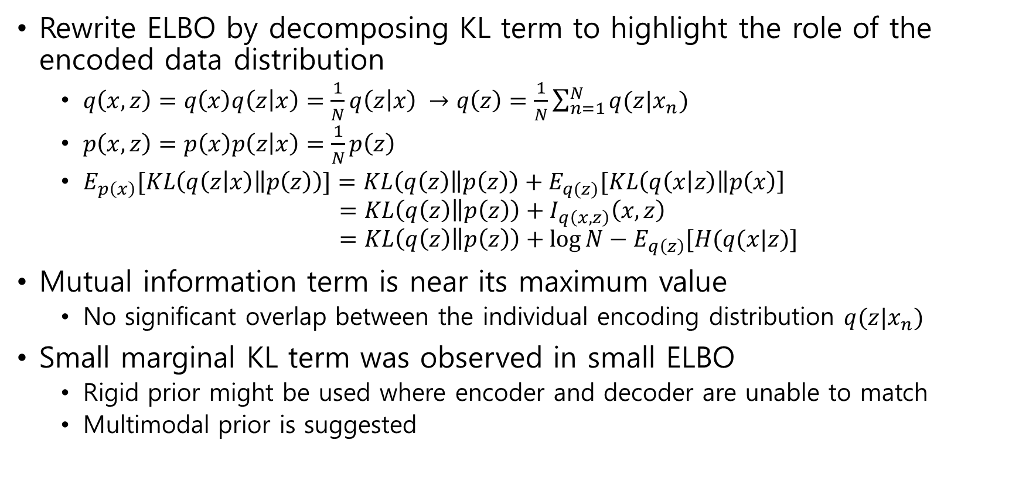
ELBO surgery
Rewrite ELBO by decomposing KL term to highlight the role of the encoded data distribution
$q\left(x,z\right)=q\left(x\right)q\left(z | x\right)=\frac{1}{N}q\left(z | x\right) →q\left(z\right)=\frac{1}{N}\sum_{n=1}^{N}{q(z|x_{n})}$
$p\left(x,z\right)=p\left(x\right)p\left(z | x\right)=\frac{1}{N}p\left(z\right)$
$E_{p\left(x\right)}[KL\left(q\left(z | x\right)\left\|p\left(z\right)\right.\right)]=KL\left(q\left(z\right)\left\|p\left(z\right)\right.\right)+E_{q(z)}[KL\left(q\left(x | z\right)\left\|p\left(x\right)\right.\right]$ $=KL\left(q\left(z\right)\left\|p\left(z\right)\right.\right)+I_{q\left(x,z\right)}\left(x,z\right)$ $=KL\left(q\left(z\right)\left\|p\left(z\right)\right.\right)+\log{N}−E_{q\left(z\right)}[H(q(x|z)]$
Mutual information term is near its maximum value
No significant overlap between the individual encoding distribution $q(z|x_{n})$
Small marginal KL term was observed in small ELBO
Rigid prior might be used where encoder and decoder are unable to match
Multimodal prior is suggested

Slide 15
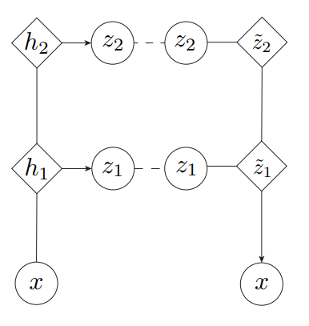
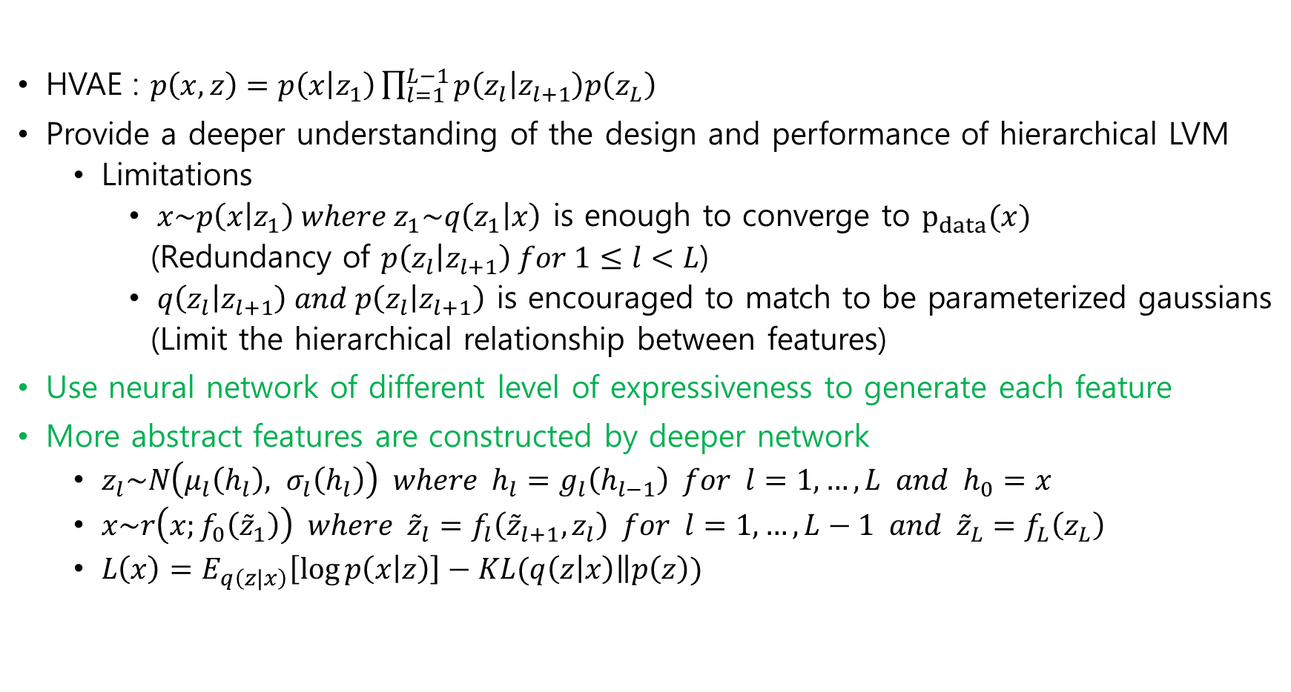
Variational Ladder Autoencoder
HVAE : $p\left(x,z\right)=p\left(x | z_{1}\right)\prod_{l=1}^{L−1}{p\left(z_{l} | z_{l+1}\right)p\left(z_{L}\right)}$
Provide a deeper understanding of the design and performance of hierarchical LVM
Limitations
$x\sim p\left(x | z_{1}\right) where z_{1}\sim q\left(z_{1} | x\right)$ is enough to converge to $p_{data}(x)$
(Redundancy of $p\left(z_{l} | z_{l+1}\right) for 1≤l<L$)
$q\left(z_{l} | z_{l+1}\right) and p\left(z_{l} | z_{l+1}\right)$ is encouraged to match to be parameterized gaussians
(Limit the hierarchical relationship between features)
Use neural network of different level of expressiveness to generate each feature
More abstract features are constructed by deeper network
$z_{l}\sim N\left(μ_{l}\left(h_{l}\right), σ_{l}\left(h_{l}\right)\right) where h_{l}=g_{l}\left(h_{l−1}\right) for l=1,…,L and h_{0}=x$
$x\sim r\left(x;f_{0}\left({\tilde{z}}_{1}\right)\right) where {\tilde{z}}_{l}=f_{l}\left({\tilde{z}}_{l+1},z_{l}\right) for l=1,…,L−1 and {\tilde{z}}_{L}=f_{L}\left(z_{L}\right)$
$L\left(x\right)=E_{q\left(z|x\right)}\left[\log{p\left(x | z\right)}\right]−KL(q\left(z | x\right)\left\|p\left(z\right)\right.)$

Slide 16
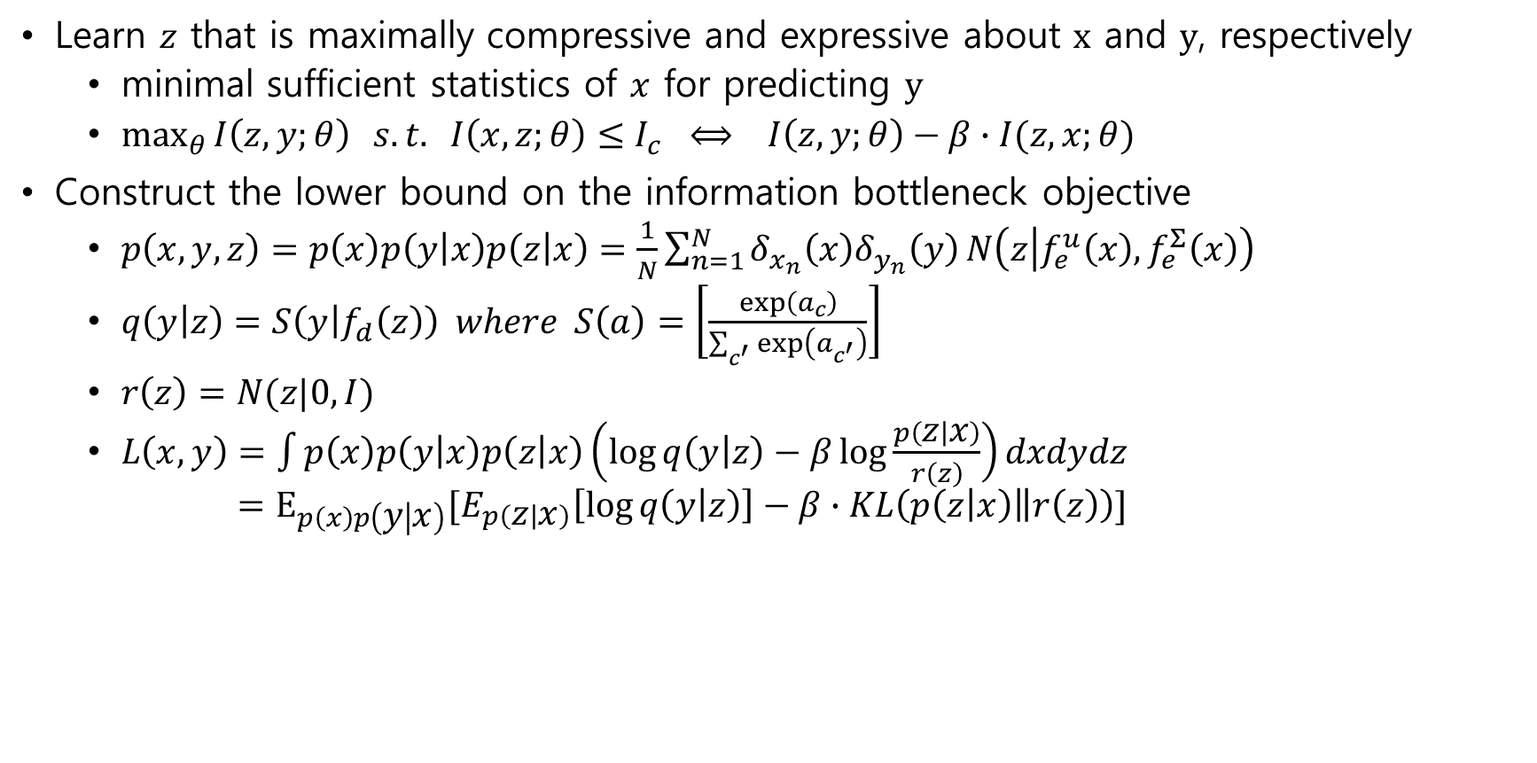
Deep Variational Information Bottleneck
Learn $z$ that is maximally compressive and expressive about $x$ and $y$, respectively
minimal sufficient statistics of $x$ for predicting $y$
$\max_{θ}{I\left(z,y;θ\right)} s.t. I\left(x,z;θ\right)≤I_{c} ⟺ I\left(z,y;θ\right)−β∙I(z,x;θ)$
Construct the lower bound on the information bottleneck objective
$p\left(x,y,z\right)=p\left(x\right)p\left(y | x\right)p\left(z | x\right)=\frac{1}{N}\sum_{n=1}^{N}{δ_{x_{n}}\left(x\right)δ_{y_{n}}\left(y\right)}N\left(z | f_{e}^{u}\left(x\right), f_{e}^{Σ}\left(x\right)\right)$
$q\left(y | z\right)=S\left(y | f_{d}\left(z\right)\right) where S\left(a\right)=\left[\frac{\exp\left(a_{c}\right)}{\sum_{c^{′}}{\exp\left(a_{c^{′}}\right)}}\right]$
$r\left(z\right)=N(z|0,I)$
$L\left(x,y\right)=\int{p\left(x\right)p\left(y | x\right)p\left(z | x\right)\left(\log{q\left(y | z\right)}−β\log{\frac{p\left(z | x\right)}{r\left(z\right)}}\right)dxdydz}$ $=E_{p\left(x\right)p\left(y | x\right)}[E_{p\left(z | x\right)}\left[\log{q\left(y | z\right)}\right]−β∙KL\left(p\left(z | x\right)\left\|r\left(z\right)\right.\right)]$

Slide 17
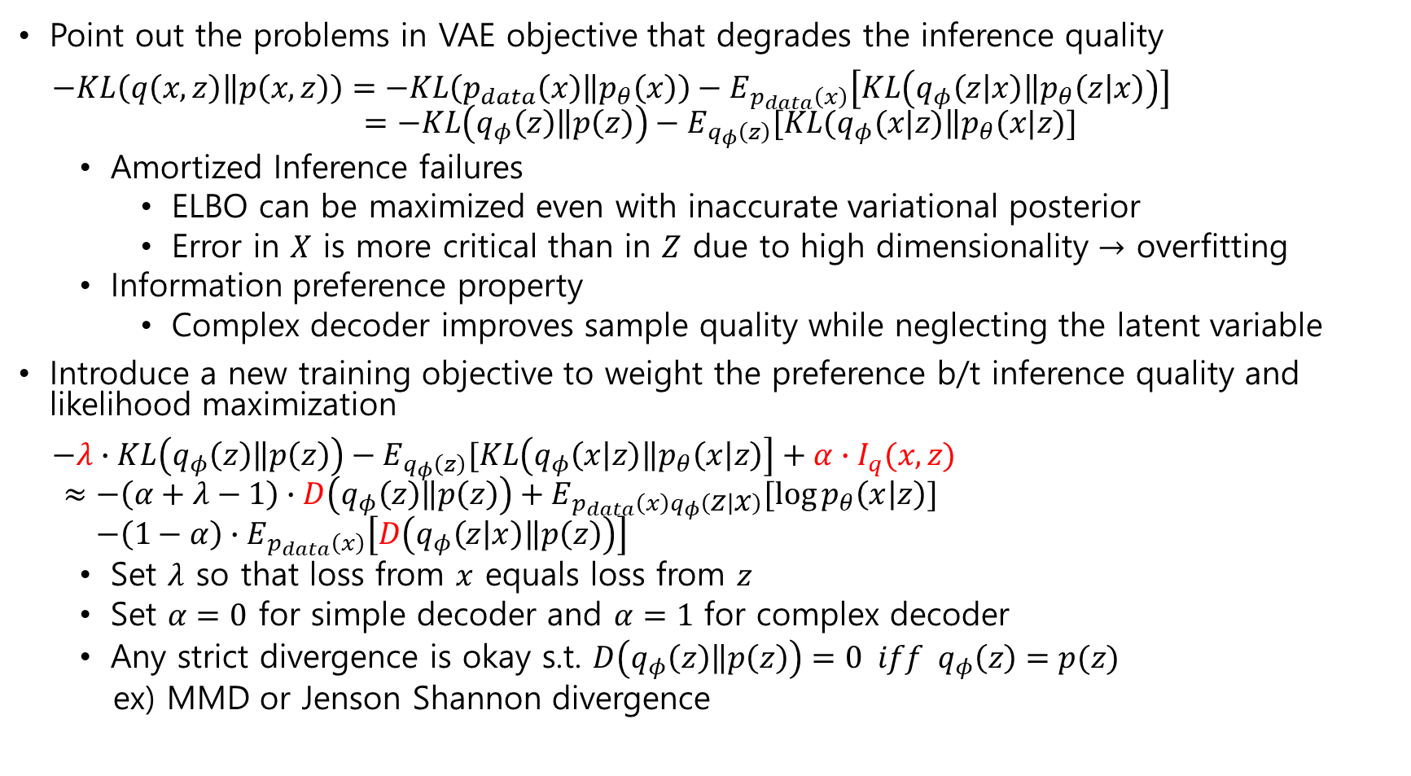
InfoVAE
Point out the problems in VAE objective that degrades the inference quality
$−KL\left(q\left(x,z\right)\left\|p\left(x,z\right)\right.\right)=−KL\left(p_{data}\left(x\right)\left\|p_{θ}\left(x\right)\right.\right)−E_{p_{data}\left(x\right)}\left[KL\left(q_{φ}\left(z | x\right)\left\|p_{θ}\left(z | x\right)\right.\right)\right]$ $=−KL\left(q_{φ}\left(z\right)\left\|p\left(z\right)\right.\right)−E_{q_{φ}\left(z\right)}[KL(q_{φ}(x|z)\left\|p_{θ}(x|z)\right.]$
Amortized Inference failures
ELBO can be maximized even with inaccurate variational posterior
Error in $X$ is more critical than in $Z$ due to high dimensionality $→$ overfitting
Information preference property
Complex decoder improves sample quality while neglecting the latent variable
Introduce a new training objective to weight the preference b/t inference quality and likelihood maximization
$−λ∙KL\left(q_{φ}\left(z\right)\left\|p\left(z\right)\right.\right)−E_{q_{φ}\left(z\right)}[KL\left(q_{φ}\left(x | z\right)\left\|p_{θ}\left(x | z\right)\right.\right]+α∙I_{q}(x,z)$ $≈−\left(α+λ−1\right)∙D\left(q_{φ}\left(z\right)\left\|p\left(z\right)\right.\right)+E_{p_{data}\left(x\right)q_{φ}\left(z | x\right)}[\log{p_{θ}\left(x | z\right)}]$ $−\left(1−α\right)∙E_{p_{data}\left(x\right)}\left[D\left(q_{φ}\left(z | x\right)\left\|p\left(z\right)\right.\right)\right]$
Set $λ$ so that loss from $x$ equals loss from $z$
Set $α=0$ for simple decoder and $α=1$ for complex decoder
Any strict divergence is okay s.t. $D\left(q_{φ}\left(z\right)\left\|p\left(z\right)\right.\right)=0 iff q_{φ}\left(z\right)=p(z)$
ex) MMD or Jenson Shannon divergence

Slide 18
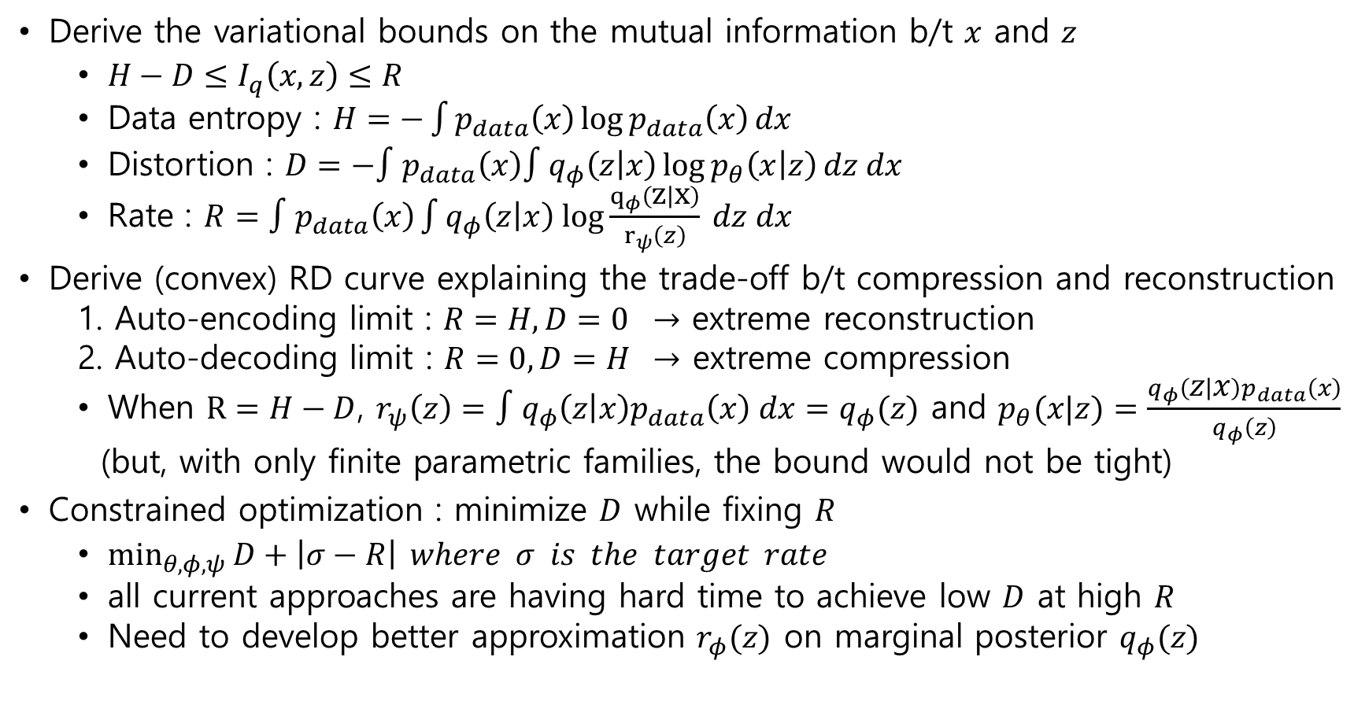
Fixing a broken ELBO
Derive the variational bounds on the mutual information b/t $x$ and $z$
$H−D≤I_{q}\left(x,z\right)≤R$
Data entropy : $H=−\int{p_{data}\left(x\right)\log{p_{data}\left(x\right)}}dx$
Distortion : $D=−∫p_{data}\left(x\right)∫q_{φ}\left(z | x\right)\log{p_{θ}\left(x | z\right)}dz dx$
Rate : $R=∫p_{data}\left(x\right)\int{q_{φ}\left(z | x\right) log\frac{q_{φ}\left(z | x\right)}{r_{ψ}\left(z\right)}} dz dx$
Derive (convex) RD curve explaining the trade-off b/t compression and reconstruction
1. Auto-encoding limit : $R=H, D=0$ $→$ extreme reconstruction
2. Auto-decoding limit : $R=0, D=H$ $→$ extreme compression
When $R=H−D$, $r_{ψ}\left(z\right)=∫q_{φ}\left(z | x\right)p_{data}\left(x\right) dx=q_{φ}(z)$ and $p_{θ}(x|z)=\frac{q_{φ}\left(z | x\right)p_{data}\left(x\right)}{q_{φ}\left(z\right)}$
(but, with only finite parametric families, the bound would not be tight)
Constrained optimization : minimize $D$ while fixing $R$
$\min_{θ,φ,ψ}{D+\left|σ−R\right|} where σ is the target rate$
all current approaches are having hard time to achieve low $D$ at high $R$
Need to develop better approximation $r_{φ}(z)$ on marginal posterior $q_{φ}(z)$

Slide 19
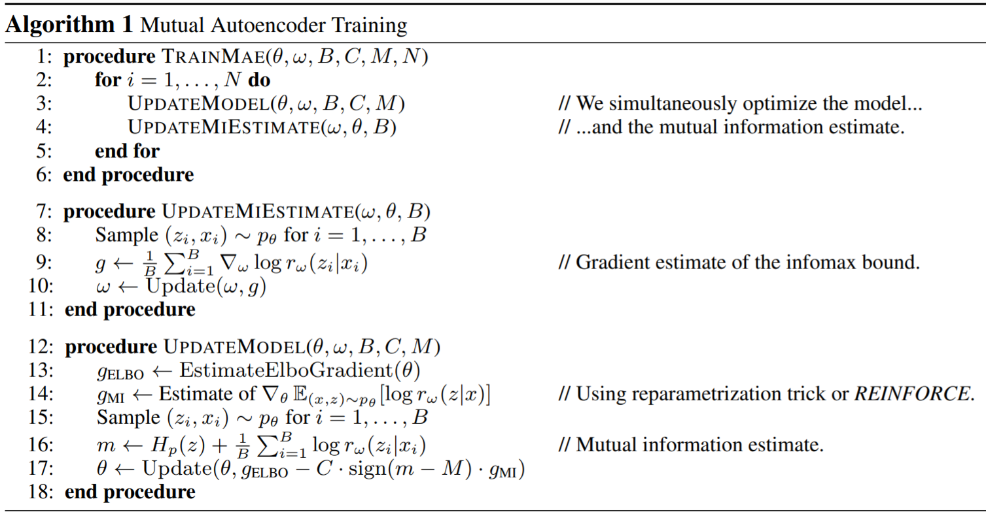

Mutual autoencoder
Forces information flow by achieving the user specified mutual information
1. $\max_{θ}{E_{p_{data}(x)}[\log{∫p_{θ}\left(x | z\right)p\left(z\right) dz}]} s.t. I_{p_{θ}}\left(x,z\right)=M$
2. $I_{p_{θ}}\left(x,z\right)≥{\hat{I}}_{p_{θ}}\left(x,z\right)=H_{p_{θ}}\left(z\right)+\max_{w}{E_{p_{θ}}\left[\log{r_{w}\left(z|x\right)}\right]}$
$E_{p_{data}\left(x\right)q_{φ}(z|x)}\left[\log{p_{φ}\left(x | z\right)}\right]−E_{p_{data}\left(x\right)}\left[KL\left(q_{φ}\left(z | x\right)\left\|p\left(z\right)\right.\right)\right]$ $−C\left|H_{p_{θ}}\left(z\right)+\max_{w}{E_{p_{θ}\left(x | z\right)p(z)}\left[\log{r_{w}\left(z|x\right)}\right]}−M\right|$

Slide 20
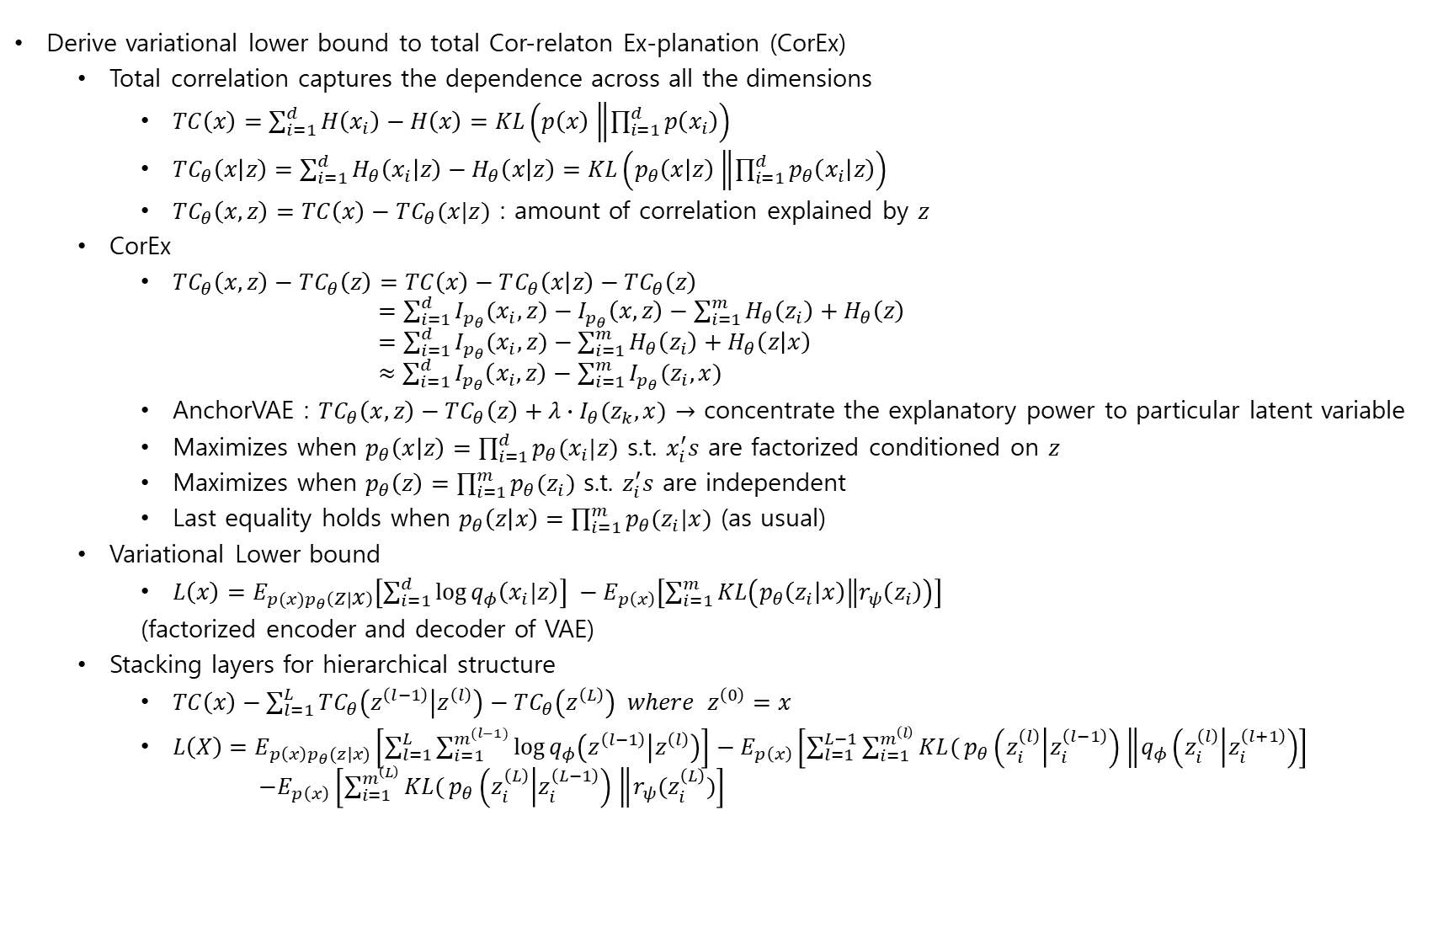
Auto-encoding total correlation explanation
Derive variational lower bound to total Cor-relaton Ex-planation (CorEx)
Total correlation captures the dependence across all the dimensions
$TC\left(x\right)=\sum_{i=1}^{d}{H\left(x_{i}\right)}−H\left(x\right)=KL\left(p\left(x\right)\left\|\prod_{i=1}^{d}{p\left(x_{i}\right)}\right.\right)$
$TC_{θ}\left(x | z\right)=\sum_{i=1}^{d}{H_{θ}\left(x_{i} | z\right)}−H_{θ}\left(x | z\right)=KL\left(p_{θ}\left(x | z\right)\left\|\prod_{i=1}^{d}{p_{θ}\left(x_{i} | z\right)}\right.\right)$
$TC_{θ}\left(x,z\right)=TC\left(x\right)−TC_{θ}(x|z)$ : amount of correlation explained by $z$
CorEx
$TC_{θ}\left(x,z\right)−TC_{θ}\left(z\right)=TC\left(x\right)−TC_{θ}\left(x | z\right)−TC_{θ}\left(z\right)$ $=\sum_{i=1}^{d}{I_{p_{θ}}(x_{i},z)}−I_{p_{θ}}\left(x,z\right)−\sum_{i=1}^{m}{H_{θ}\left(z_{i}\right)}+H_{θ}\left(z\right)$ $=\sum_{i=1}^{d}{I_{p_{θ}}(x_{i},z)}−\sum_{i=1}^{m}{H_{θ}\left(z_{i}\right)}+H_{θ}\left(z | x\right)$ $≈\sum_{i=1}^{d}{I_{p_{θ}}\left(x_{i},z\right)}−\sum_{i=1}^{m}{I_{p_{θ}}(z_{i},x)}$
AnchorVAE : $TC_{θ}\left(x,z\right)−TC_{θ}\left(z\right)+λ∙I_{θ}(z_{k}, x)$ $→$ concentrate the explanatory power to particular latent variable
Maximizes when $p_{θ}\left(x | z\right)=\prod_{i=1}^{d}{p_{θ}(x_{i}|z)}$ s.t. $x_{i}^{′}s$ are factorized conditioned on $z$
Maximizes when $p_{θ}\left(z\right)=\prod_{i=1}^{m}{p_{θ}(z_{i})}$ s.t. $z_{i}^{′}s$ are independent
Last equality holds when $p_{θ}\left(z | x\right)=\prod_{i=1}^{m}{p_{θ}(z_{i}|x)}$ (as usual)
Variational Lower bound
$L\left(x\right)=E_{p(x)p_{θ}\left(z | x\right)}\left[\sum_{i=1}^{d}{\log{q_{φ}\left(x_{i}|z\right)}}\right] −E_{p\left(x\right)}\left[\sum_{i=1}^{m}{KL\left(p_{θ}\left(z_{i} | x\right)\left\|r_{ψ}\left(z_{i}\right)\right.\right)}\right]$
(factorized encoder and decoder of VAE)
Stacking layers for hierarchical structure
$TC\left(x\right)−\sum_{l=1}^{L}{TC_{θ}\left(z^{\left(l−1\right)} | z^{\left(l\right)}\right)}−TC_{θ}\left(z^{\left(L\right)}\right) where z^{\left(0\right)}=x$
$L\left(X\right)=E_{p\left(x\right)p_{θ}(z|x)}\left[\sum_{l=1}^{L}{\sum_{i=1}^{m^{(l−1)}}{\log{q_{φ}\left(z^{\left(l−1\right)} | z^{\left(l\right)}\right)}}}\right]−E_{p\left(x\right)}\left[\sum_{l=1}^{L−1}{\sum_{i=1}^{m^{\left(l\right)}}{KL(}p_{θ}\left(z_{i}^{\left(l\right)} | z_{i}^{\left(l−1\right)}\right)\left\|q_{φ}\left(z_{i}^{\left(l\right)} | z_{i}^{\left(l+1\right)}\right)\right.}\right]$ $−E_{p\left(x\right)}\left[\sum_{i=1}^{m^{\left(L\right)}}{KL(}p_{θ}\left(z_{i}^{\left(L\right)} | z_{i}^{\left(L−1\right)}\right)\left\|r_{ψ}(z_{i}^{\left(L\right)})\right.\right]$

